Slide 1




COURSE ARTIFICIAL INTELLIGENCE AND DEEP LEARNING (AIDL)
UNIT-VI
Mr. P Ramu,Assistant Professor

Slide 2
DEEP REINFORCEMENT LEARNING:
1. Deep Reinforcement Learning Masters Atari Games
2. Reinforcement Learning
3. Markov Decision Processes (MDP)
4. Explore Versus Exploit
5. Pole Cart with Policy Gradients
6. Q - Learning and Deep Q-Networks
7. Improving and Moving Beyond DQN.

Slide 3
Deep Reinforcement Learning
Definition:
1. Reinforcement learning, which is a branch of machine learning that deals with learning via interaction and feedback.
2. Reinforcement learning is essential to building agents that can not only perceive and interpret the world, but also take action and interact with it.
3. Discuss how to incorporate deep neural networks into the framework of reinforcement learning and discuss recent advances and improvements in this field.

Slide 4
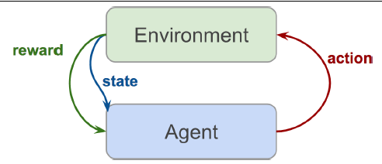
What Is Reinforcement Learning?
Reinforcement learning, at its essentials, is learning by interacting with an environment.
Learning process involves an actor, an environment, and a reward signal.
The actor chooses to take an action in the environment, for which the actor is rewarded accordingly.
The way in which an actor chooses actions is called a policy.
The actor wants to increase the reward it receives, and so must learn an optimal policy for interacting with the environment (Figure 9-2).
Reinforcement learning is different from the other types of learning that we have covered thus far.
In traditional supervised learning, we are given data and labels, and are tasked with predicting labels given data.
Figure 9-2. Reinforcement learning setup
In unsupervised learning, we are given just data and are tasked with discovering underlying structure in this data.
In reinforcement learning, we are given neither data nor labels.
Learning signal is derived from the rewards given to the agent by the environment.

Slide 5
1. Deep Reinforcement Learning Masters Atari Games
1. Introduction
2. Problem Statement
3. Key Idea
4. Reinforcement Learning Setup
5. Deep Q-Network (DQN)
6. Key Techniques Used
7. Training Process
8. Achievements
9. Importance
10. Limitations
11. Improvements Beyond DQN

Slide 6
1. Introduction
A major breakthrough in AI occurred when DeepMind developed a system that could learn to play Atari video games directly from raw pixels, achieving human-level performance. This approach combines Reinforcement Learning (RL) with Deep Learning, known as Deep Reinforcement Learning (DRL).
2. Problem Statement
Input: Raw game frames (pixel images)
Output: Game actions (left, right, fire, etc.)
Goal: Maximize total score
->No manual feature extraction is used.

Slide 7
3. Key Idea
Use a Deep Q-Network (DQN) to:
Learn directly from images
Estimate Q-values for actions
Select optimal actions
4. Reinforcement Learning Setup
Agent: Game player
Environment: Atari game
State: Current screen (image)
Action: Game controls
Reward: Score change
Objective: Maximize cumulative reward.

Slide 8
5. Deep Q-Network (DQN)
Concept
DQN combines:
Q-Learning (RL)
Deep Neural Networks
Input
Sequence of frames
Output
Q-values for each action

Slide 9
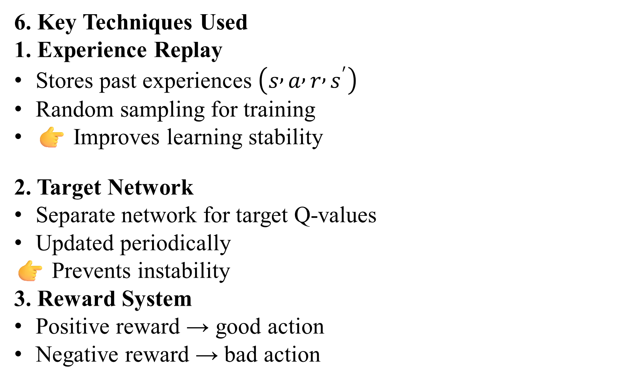
6. Key Techniques Used
1. Experience Replay
Stores past experiences $\left(s , a , r , s^{′}\right)$
Random sampling for training
👉 Improves learning stability
2. Target Network
Separate network for target Q-values
Updated periodically
👉 Prevents instability
3. Reward System
Positive reward → good action
Negative reward → bad action

Slide 10
7. Training Process
Observe game state
Choose action (ε-greedy)
Execute action
Receive reward
Store experience
Train neural network
Update Q-values
8. Achievements
Played 49 Atari games
Achieved human-level performance
Learned strategies like:
Paddle control in Pong
Brick breaking in Breakout
9. Importance
First system to learn from raw pixels
No domain-specific knowledge required
Same model works across multiple games
👉 Major milestone in AI

Slide 11
10. Limitations
High training time
Requires GPUs
Performance varies across games
11. Improvements Beyond DQN
Double DQN: Reduces overestimation
Dueling DQN: Separates value & advantage
Prioritized Replay: Focus on important data
Actor-Critic: Combines policy & value methods

Slide 12
2. Reinforcement Learning
1. Definition
Reinforcement Learning (RL) is a type of machine learning where an agent learns by interacting with an environment and improves its actions based on rewards or penalties. It is a key concept in Artificial Intelligence.
2. Basic Components
Agent → Learner/decision maker
Environment → External system
State (S) → Current situation
Action (A) → Choice made by agent
Reward (R) → Feedback signal
Policy (π) → Strategy for selecting actions

Slide 13
3. Working of RL
Agent → Action → Environment → Reward → New State → Agent
Goal: Maximize cumulative reward
4. Key Concepts
Reward
Immediate feedback after action
Return
Total accumulated reward
Discount Factor (γ)
Importance of future rewards

Slide 14
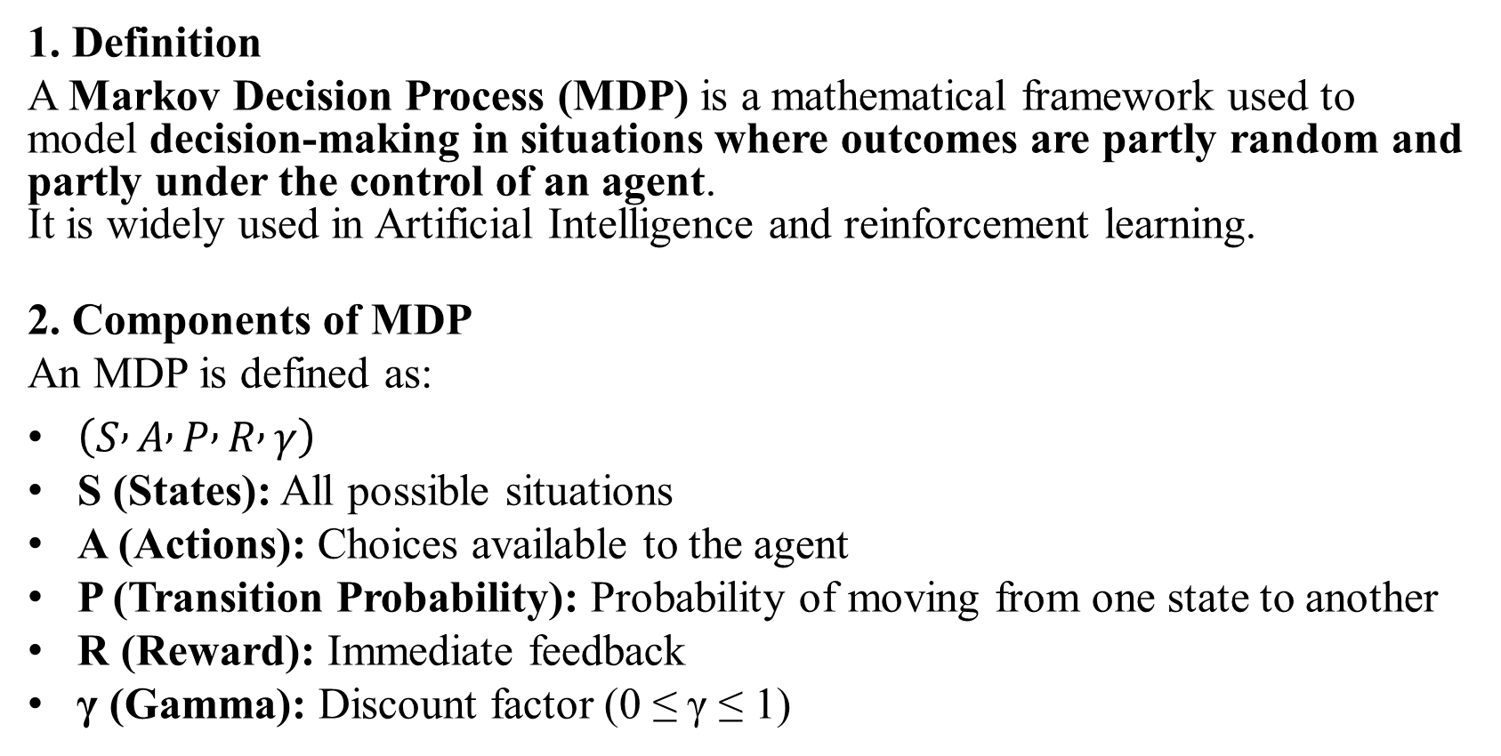
3. Markov Decision Processes (MDP)
1. Definition
A Markov Decision Process (MDP) is a mathematical framework used to model decision-making in situations where outcomes are partly random and partly under the control of an agent. It is widely used in Artificial Intelligence and reinforcement learning.
2. Components of MDP
An MDP is defined as:
$\left(S , A , P , R , γ\right)$
S (States): All possible situations
A (Actions): Choices available to the agent
P (Transition Probability): Probability of moving from one state to another
R (Reward): Immediate feedback
γ (Gamma): Discount factor (0 ≤ γ ≤ 1)

Slide 15
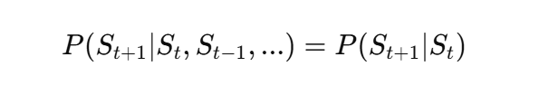
3. Markov Property
Future state depends only on the present state, not on past states.
4. Working of MDP
Current State → Action → Next State → Reward
The agent selects actions to maximize total reward over time.
5. Policy (π)
A policy defines the agent’s behavior
Maps states → actions
Optimal policy = best strategy for maximum reward

Slide 16
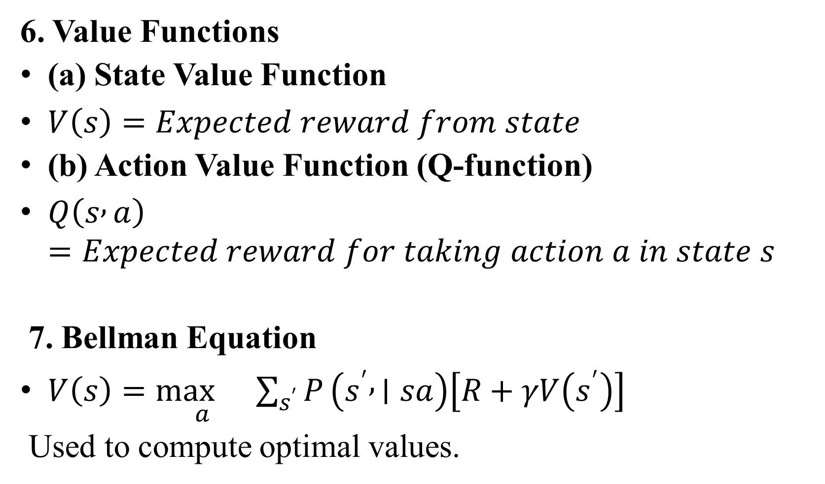
6. Value Functions
(a) State Value Function
$V\left(s\right)=Expected reward from state$
(b) Action Value Function (Q-function)
$Q\left(s , a\right)=Expected reward for taking action a in state s$
7. Bellman Equation
$V\left(s\right)=\underset{a}{\max{}}\sum_{s^{′}}{P}\left(s^{′} , ∣sa\right)\left[R+γV\left(s^{′}\right)\right]$
Used to compute optimal values.

Slide 17
8. Solution Methods
1. Value Iteration
Repeatedly update values
Converges to optimal solution
2. Policy Iteration
Policy evaluation
Policy improvement
9. Example
Robot navigation:
States → Locations
Actions → Move directions
Reward → Goal reached 10. Applications
Robotics
Game playing
Self-driving cars
11. Advantages
Handles uncertainty
Provides optimal decisions
Widely applicable
12. Limitations
Large state space problem
Requires known probabilities

Slide 18
4. Explore Versus Exploit
1. Definition
The Explore vs Exploit trade-off is a key concept in reinforcement learning where an agent must choose between:
Exploration → Trying new actions to discover better rewards
Exploitation → Using known actions that already give high rewards
👉 The challenge is to balance both to maximize long-term reward.

Slide 19
2. Explanation
Exploration
Tries unknown actions
Gains new knowledge
May give low reward initially
Example: Trying a new path in a maze
Exploitation
Uses best-known action
Gives immediate high reward
Example: Repeating the shortest known path
3. Trade-off Problem
Too much exploration → Wastes time, low reward
Too much exploitation → May miss better solutions
Need a balance for optimal learning.

Slide 20
4. Methods to Balance
1. ε-Greedy Strategy
With probability ε → explore
With probability 1–ε → exploit
2. Decaying ε
Start with high exploration
Gradually reduce exploration
3. Softmax (Boltzmann)
Select actions based on probability
Better actions chosen more often
4. Upper Confidence Bound (UCB)
Balances reward and uncertainty

Slide 21
5. Example
In a game:
Exploration → Try new moves
Exploitation → Use best move found
6. Importance
Ensures learning of optimal policy
Avoids local optimum
Improves long-term performance
7. Applications
Game playing (Atari, Chess)
Robotics
Recommendation systems

Slide 22
5. Pole Cart with Policy Gradients
1. Introduction
The Pole–Cart (CartPole) problem is a classic control task in reinforcement learning where an agent must balance a pole upright on a moving cart. It is widely used to demonstrate policy-based methods, especially Policy Gradient algorithms. 2. Problem Description
A cart can move left or right on a track
A pole is attached and tends to fall due to gravity
The agent must keep the pole balanced (upright)

Slide 23
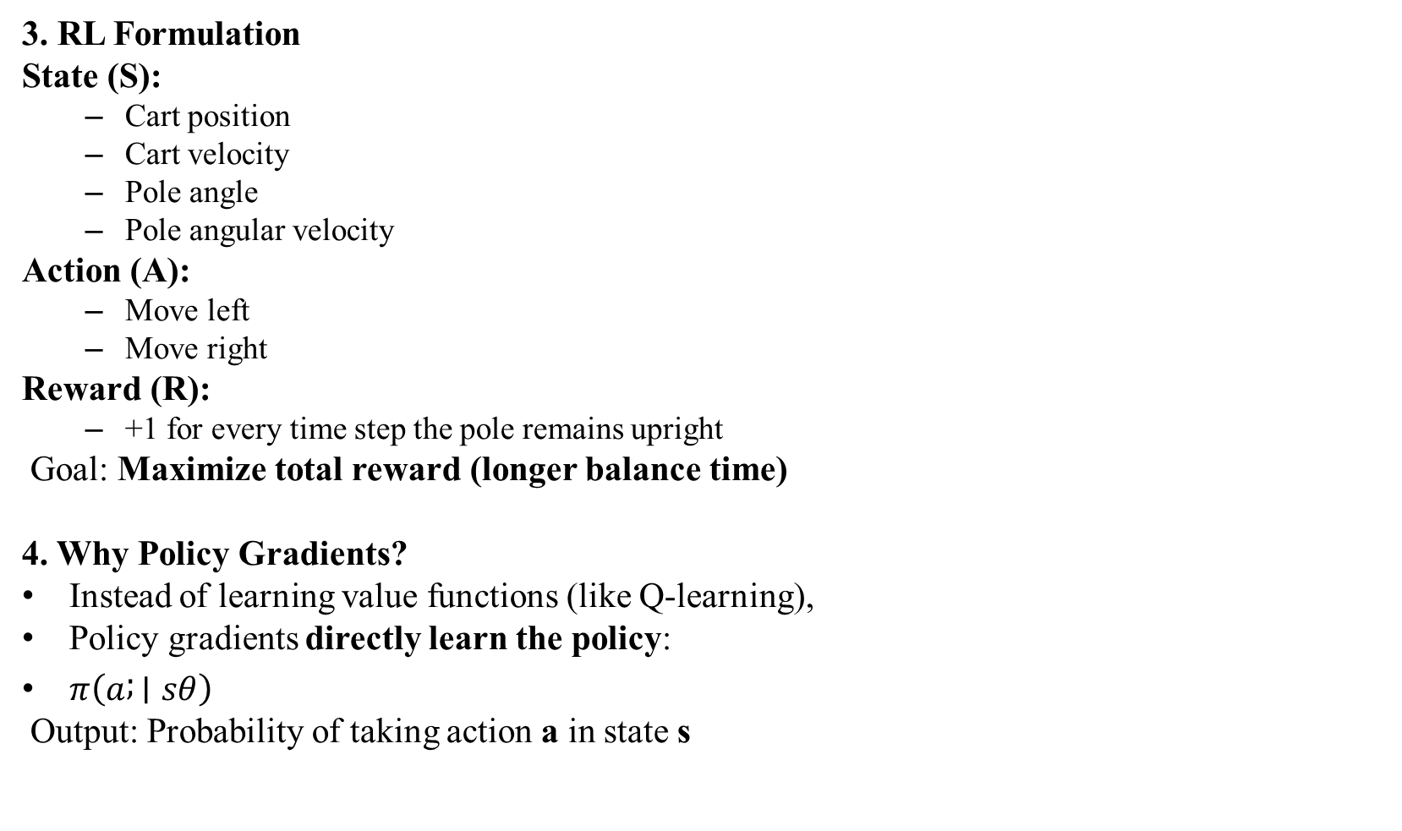
3. RL Formulation
State (S):
Cart position
Cart velocity
Pole angle
Pole angular velocity
Action (A):
Move left
Move right
Reward (R):
+1 for every time step the pole remains upright
Goal: Maximize total reward (longer balance time)
4. Why Policy Gradients?
Instead of learning value functions (like Q-learning),
Policy gradients directly learn the policy:
$π\left(a ; ∣sθ\right)$
Output: Probability of taking action a in state s

Slide 24
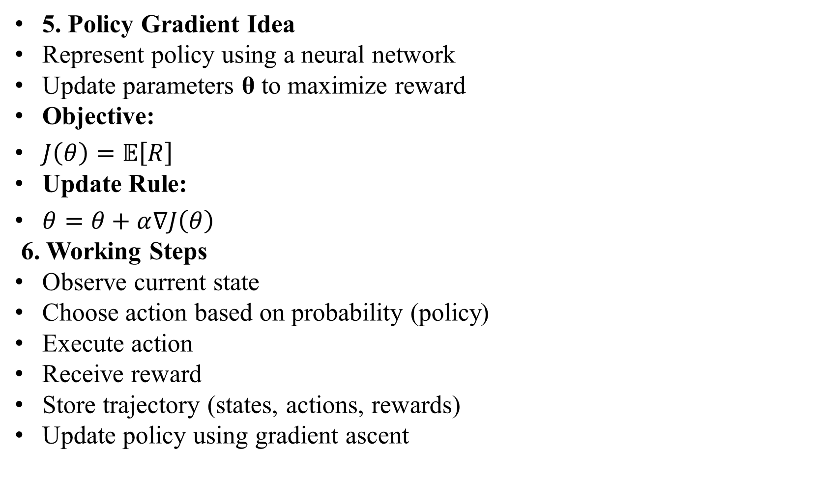
5. Policy Gradient Idea
Represent policy using a neural network
Update parameters θ to maximize reward
Objective:
$J\left(θ\right)=𝔼\left[R\right]$
Update Rule:
$θ=θ+α∇J\left(θ\right)$
6. Working Steps
Observe current state
Choose action based on probability (policy)
Execute action
Receive reward
Store trajectory (states, actions, rewards)
Update policy using gradient ascent

Slide 25
7. Algorithm (Simple)
1. Initialize policy parameters
2. Repeat:
Generate episode
Compute rewards
Update policy
3. Until pole stays balanced
8. Advantages
Works well in continuous action spaces
Learns stochastic policies
No need to store Q-values

Slide 26
9. Limitations
High variance in learning
Slow convergence
Sensitive to hyperparameters
10. Applications
Robotics control
Game AI
Autonomous systems

Slide 27
6. Q - Learning and Deep Q-Networks
1. Introduction
Q-Learning is a model-free reinforcement learning algorithm that learns the optimal action-value function. When combined with neural networks, it becomes a Deep Q-Network (DQN), enabling learning from high-dimensional inputs like images. These methods are central to Artificial Intelligence and modern reinforcement learning.

Slide 28
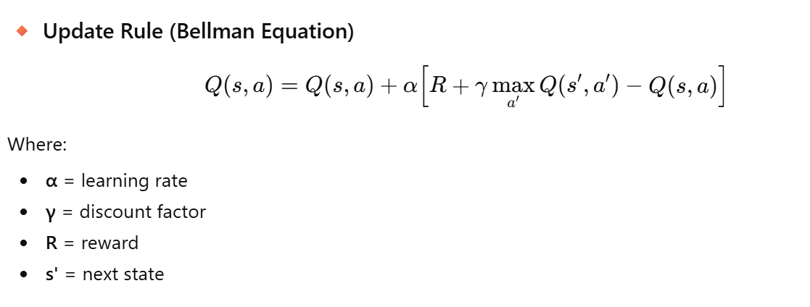

2. Q-Learning
🔸 Definition
Q-Learning learns the value of taking an action in a given state:
$Q\left(s , a\right)$
👉 Goal: Find optimal policy that maximizes cumulative reward.

Slide 29
Working Steps
Initialize Q-table
Observe state
Choose action (ε-greedy)
Execute action
Update Q-value
Repeat
Advantages
Simple and effective
Learns optimal policy
No model required
Limitations
Not scalable to large state spaces
Requires Q-table (memory issue)

Slide 30
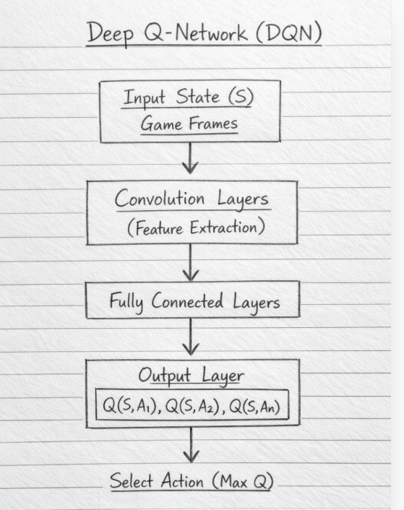
3. Deep Q-Network (DQN)
🔸 Definition
DQN replaces the Q-table with a deep neural network to approximate Q-values.

Slide 31
Key Techniques
1. Experience Replay
Stores past experiences
Random sampling for training
2. Target Network
Separate network for stable learning
Working Steps
Observe state
Select action (ε-greedy)
Execute action
Store experience (s,a,r,s')
Sample mini-batch
Train neural network
Update target network

Slide 32
Advantages
Handles large state spaces
Works with images
Learns complex patterns
Limitations
Requires high computation
Training instability
Needs large data
Applications
Game playing (Atari)
Robotics
Autonomous vehicles

Slide 33
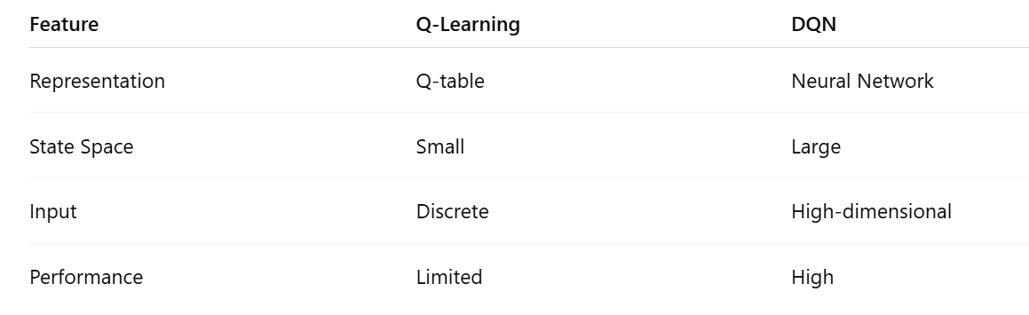
Q-Learning vs DQN

Slide 34
7. Improving and Moving Beyond DQN
1. Introduction
While Deep Q-Networks (DQN) achieved great success (e.g., Atari games by DeepMind), they have limitations such as overestimation, instability, and inefficient learning. To overcome these issues, several improved algorithms were developed. 2. Limitations of DQN
Overestimation of Q-values
Slow learning
Correlated data issues
Poor sample efficiency
Instability during training

Slide 35

3. Improvements Over DQN
1. Double DQN (DDQN)
Problem: DQN overestimates Q-values
Solution:
Uses two networks:
One for action selection
One for evaluation
✔ Reduces overestimation ✔ Improves accuracy
2. Dueling DQN
Idea: Separate learning into:
State Value V(s)
Advantage A(s,a)
$Q\left(s , a\right)=V\left(s\right)+A\left(s , a\right)$
✔ Better learning of important states ✔ Faster convergence

Slide 36
3. Prioritized Experience Replay
Problem: Random sampling treats all experiences equally
Solution:
Prioritize important experiences (high error)
✔ Learns faster ✔ Improves efficiency
4. Noisy Networks
Problem: Exploration using ε-greedy is inefficient
Solution:
Add noise to network weights
✔ Better exploration ✔ No need for ε-greedy
5. Multi-Step Learning
Instead of one-step reward:
Uses multiple future rewards
✔ Faster learning ✔ Better reward propagation

Slide 37
4. Advanced Methods Beyond DQN
1. Policy Gradient Methods
Directly learn policy
Suitable for continuous actions
2. Actor-Critic Methods
Combines:
Actor: Selects action
Critic: Evaluates action
✔ Stable learning ✔ Faster convergence
3. A3C (Asynchronous Advantage Actor-Critic)
Multiple agents learn in parallel
Faster and more stable
4. PPO (Proximal Policy Optimization)
Limits large updates
Stable and widely used

Slide 38
